Slide 1
A Storyboard of the Theoretical GMO Commercial
Raymond Wu

Slide 2
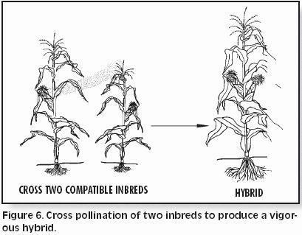
Scene 1: genetic Engineering in Ancient TImes

Slide 3

Scene 2: Nothing
“Oh okay, that’s normal”

Slide 4
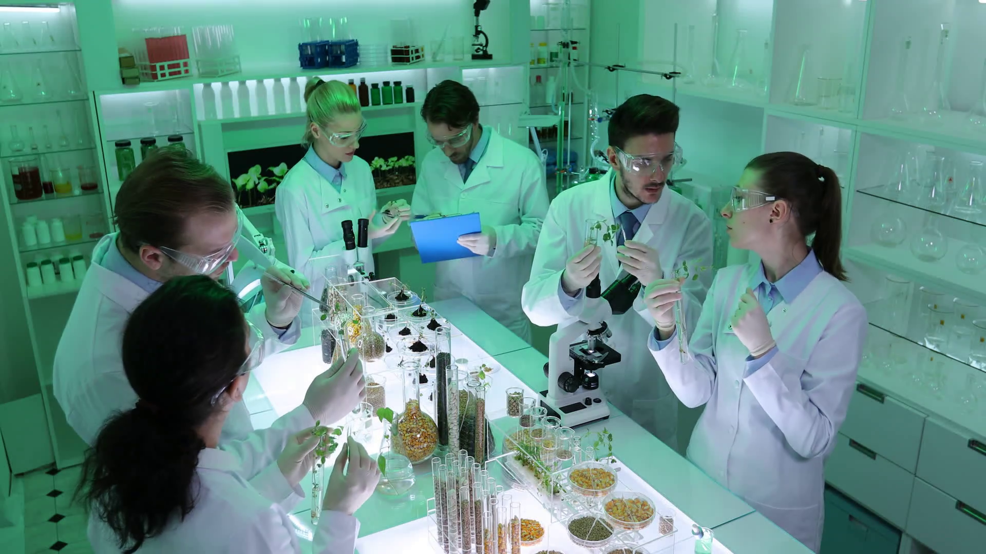
Scene 3: Genetic engineering in a lab

Slide 5

Scene 4: Reaction

Slide 6
Scene 5: What’s the Difference?
”What’s the Difference?”

Slide 7
References
How Corn Hybrids Are Developed, www.farmwest.com/book/export/html/31.
“Cereal Guy.” Know Your Meme, 10 Nov. 2018, knowyourmeme.com/memes/cereal-guy.
“PNG All.” PNG All RSS, www.pngall.com/cereal-guy-png
“Researchers Team Doing Research Activity Genetic Engineering Plants Laboratory Stock Video Footage - Storyblocks Video.” Royalty Free Stock Video, Footage, Backgrounds and More, www.videoblocks.com/video/researchers-team-doing-research-activity-genetic-engineering-plants-laboratory-bm2gtfpm2gj0nn02na.

